Slide 1
ChartNotes
Presenters:
Alex
Mehak
Nisha
Tian
Xinyu
#healthdata
Final Project Presentation

Slide 2
Do you always fill out forms when you go to the doctor?
...even though you swear you filled out these same forms the last time you went?
Notes:
Alex read this

Slide 3
Is it challenging to remember all of your family history?
...especially any health conditions of your grandparents or parents?
Notes:
Xin
Is it challenging to remember all of your family history? Especially any health conditions of your grandparents or parents?

Slide 4
Do you ever forget to bring your insurance card with you to a new facility?
...have you accidentally brought your dental insurance card to your eye appointment?
Notes:
Mehak

Slide 5
Do you wish your health providers could share information to reduce the number of forms you have to fill?
...well they can’t..
Notes:
Nisha

Slide 6

But you can,
using ChartNotes!
Notes:
Tian read this
But you can,
using ChartNotes!

Slide 7
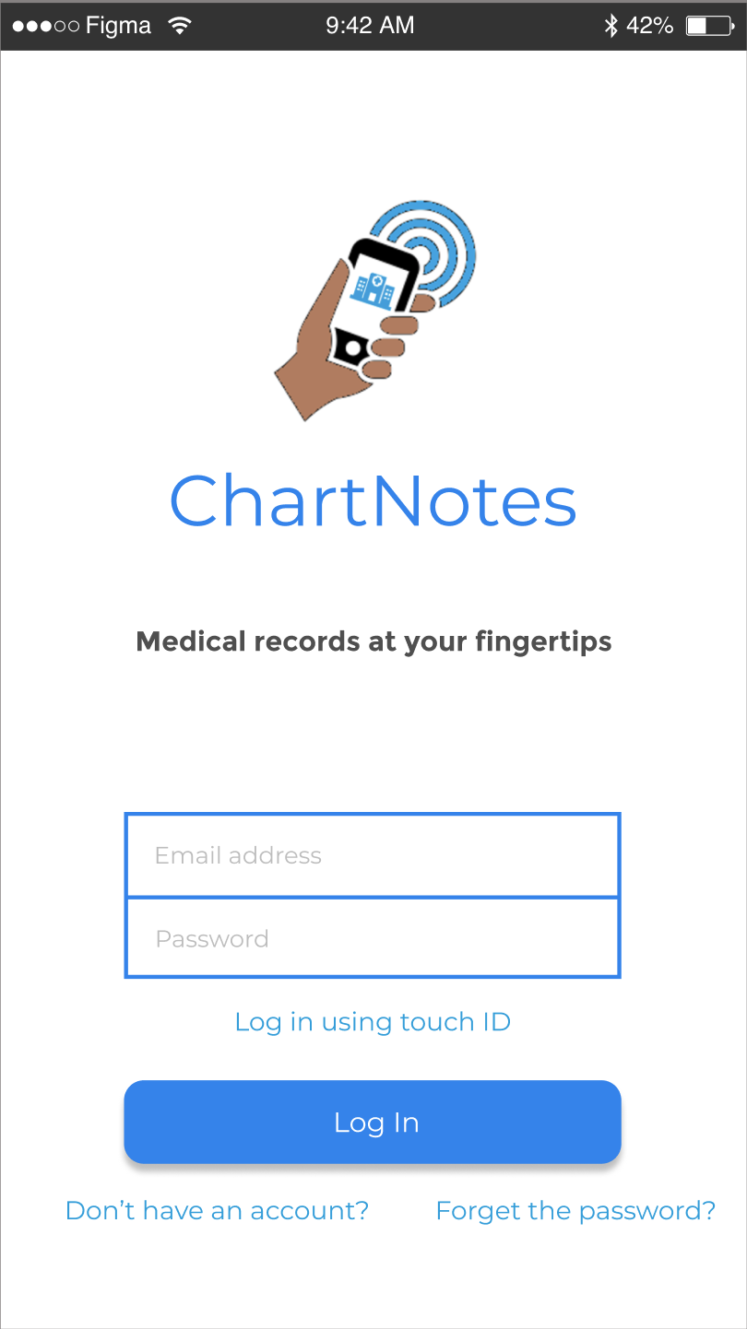
ChartNotes
ChartNotes primarily focuses on the ability to share your medical chart information with your healthcare provider.
Forms
Family
Insurance
Share
Notes:
Tian
ChartNotes primarily focuses on the ability to share your medical chart information with your healthcare provider.
We are going to discuss four main features we have prototyped in our app: forms, family, insurance, share.

Slide 8
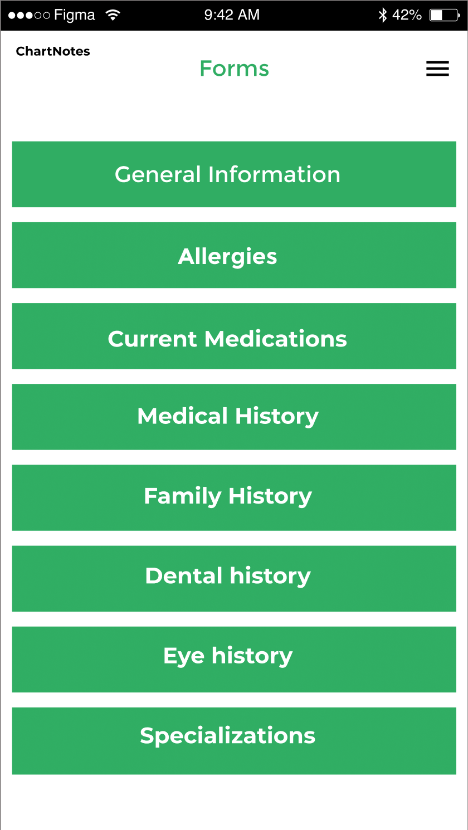
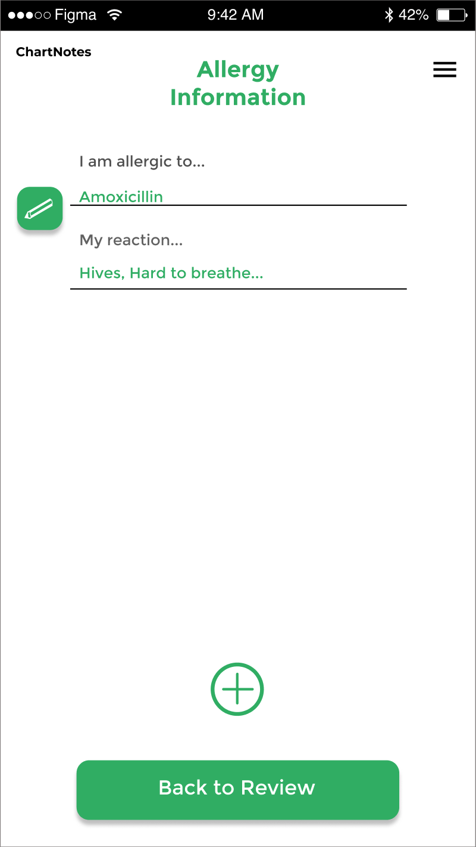
Forms
Fill out forms once!
Store your forms for easy changes at any time.
Remember all your medical history (including immunizations or surgeries!
Notes:
Alex

Slide 9
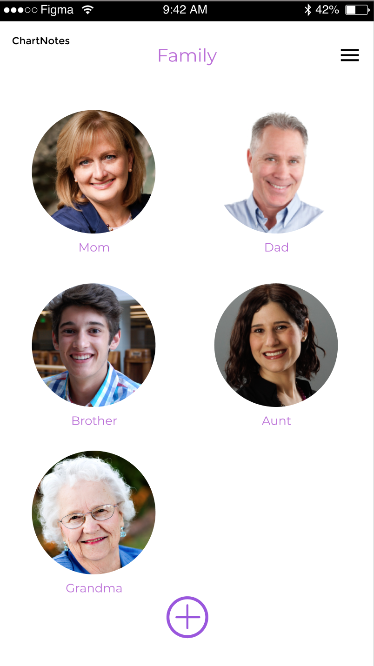
Family
Connect with your family to easily fill out your family history form!
You cannot see their forms and they cannot see your forms. Only relevant information will automatically answer your forms.
You can always add information to your family form as well.
Notes:
Xin
Connecting with your family, what does it do? The answer is, to easily fill out your family history form!
But somebody might be worry about their privacy. Well, you don’t need to. Because after connecting with your family, you cannot see their forms and they cannot see your forms. Only relevant information will automatically answer your forms.
What’s more, you can always add information to your family forms after making connections as well.

Slide 10
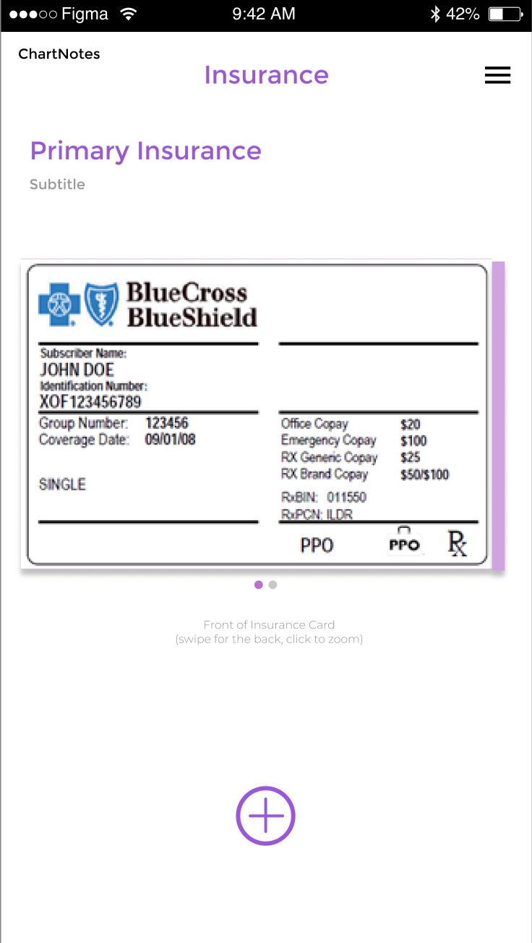
Insurance
Add all your insurance cards!
Swipe left and right to see the back
Label any insurance cards you have
Primary, Eye, Dental...etc
Update insurance cards annually
You’ll never forget an insurance card again!
Notes:
Mehak

Slide 11
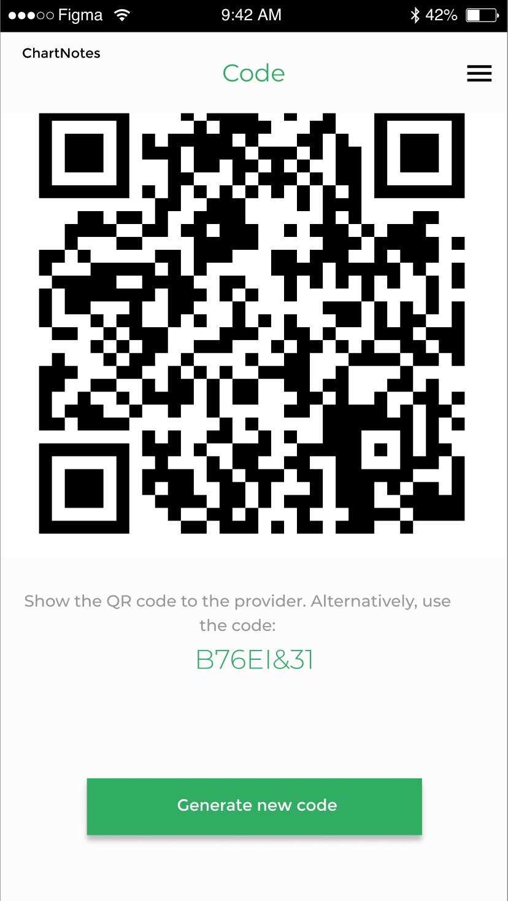
Share
Share your information securely!
Each time you go to the Share screen, new temporary codes (QR and numerical) are generated for secure transfer of your information.
The app maps who (facility) is allowed to collect what information (relevant forms) to ensure privacy of your medical information.
Notes:
Nisha
Here we have assumed that the required forms is shared as per what the facility needs.
One thing we were discussing in the future when we add facility is that the patients can select the forms they want to share when the code is scanned.

Slide 12
Demo of the Prototype
Link to prototype - Here

Slide 13
Future
Create a better landing page
Create a tutorial for first time users
Provide smart insurance information
Add the Health Facility as a user
Request Appointment
Pre and Post tasks.
Notes:
Tian
These are the changes that we would make in the future.
First three are from our valuations sprint.
Create a better landing page
Create a tutorial for first time users
Providing smart insurance information
###Xin
Since our application is for both patients and facilities, in the future we would also create pages and functions for health facilities.
Also, we would add the function to request appointment.
At last, if we had the appointment function, then it is possible to attach some pre and post tasks such as no eating before the body check and how to take medicine.

Slide 14
Thank You!
Do you have any questions or feedback?
Notes:
Mehak

